Slide 1
Digital Portfolio
STUDENT NAME: ANANTHI A
REGISTER NO AND NMID:asanm10824131081802522006
DEPARTMENT: B. SC-computer science
COLLEGE:TKGAC, Annamalai university

Slide 2
PROJECT TITLE Creative My Portfolio using FWD

Slide 3


AGENDA
Problem Statement
Project Overview
End Users
Tools and Technologies
Portfolio design and Layout
Features and Functionality
Results and Screenshots
Conclusion
Github Link
3/21/2024 Annual Review

Slide 4

PROBLEM STATEMENT
In today’s digital era, showcasing skills, achievements, and projects effectively is a challenge for many individuals. Traditional paper resumes and static profiles often fail to highlight a person’s creativity, technical abilities, and unique strengths in an engaging way. This creates a gap between individuals and opportunities, as recruiters, educators, or clients may not fully recognize their potential.

Slide 5

PROJECT OVERVIEW
The portfolio includes sections such as personal details, problem statement, skills, project works, and reflections. Each part has been carefully designed to demonstrate both theoretical knowledge and practical application
By presenting my work digitally, this project not only reflects my progress and capabilities but also serves as a tool for continuous learning, self-assessment, and future opportunities.

Slide 6

WHO ARE THE END USERS? ✨SOFTWARE ✨EDUCATIONAL INATITUTIONAL ✨EMPLOYERS ✨STUDENTS ✨JOB SEEKERS

Slide 7

TOOLS AND TECHNIQUES
HTML5 & CSS3 – For structuring and styling the portfolio web pages.
JavaScript – To add interactivity, animations, and dynamic content.
Visual Studio Code – As the primary code editor for development.
Responsive Design – Ensuring the portfolio works seamlessly across all devices.

Slide 8
PORTOFOLIO DESIGN AND LAYOUT
1. Clean and Minimalist Design – The portfolio uses a simple color scheme and organized sections to avoid clutter and ensure easy readability.
2. Consistent Layout – Uniform fonts, headings, and spacing across all pages create a cohesive look.
3. Navigation Menu – A clear menu allows users to quickly access sections such as About Me, Skills, Projects, and Contact.
4. Responsive Design – The layout adapts to various devices including desktops, tablets, and smartphones.
8

Slide 9
FEATURES AND FUNCTIONALITY
1. User-Friendly Interface – A clean and simple design that makes the portfolio easy to navigate.
2. Personal Information Section – Highlights background, education, and career objectives.
3. Skills Showcase – Displays technical and soft skills in an organized manner.
4. Project Gallery – Contains details of academic and professional projects with descriptions, outcomes, and screenshots.

Slide 10
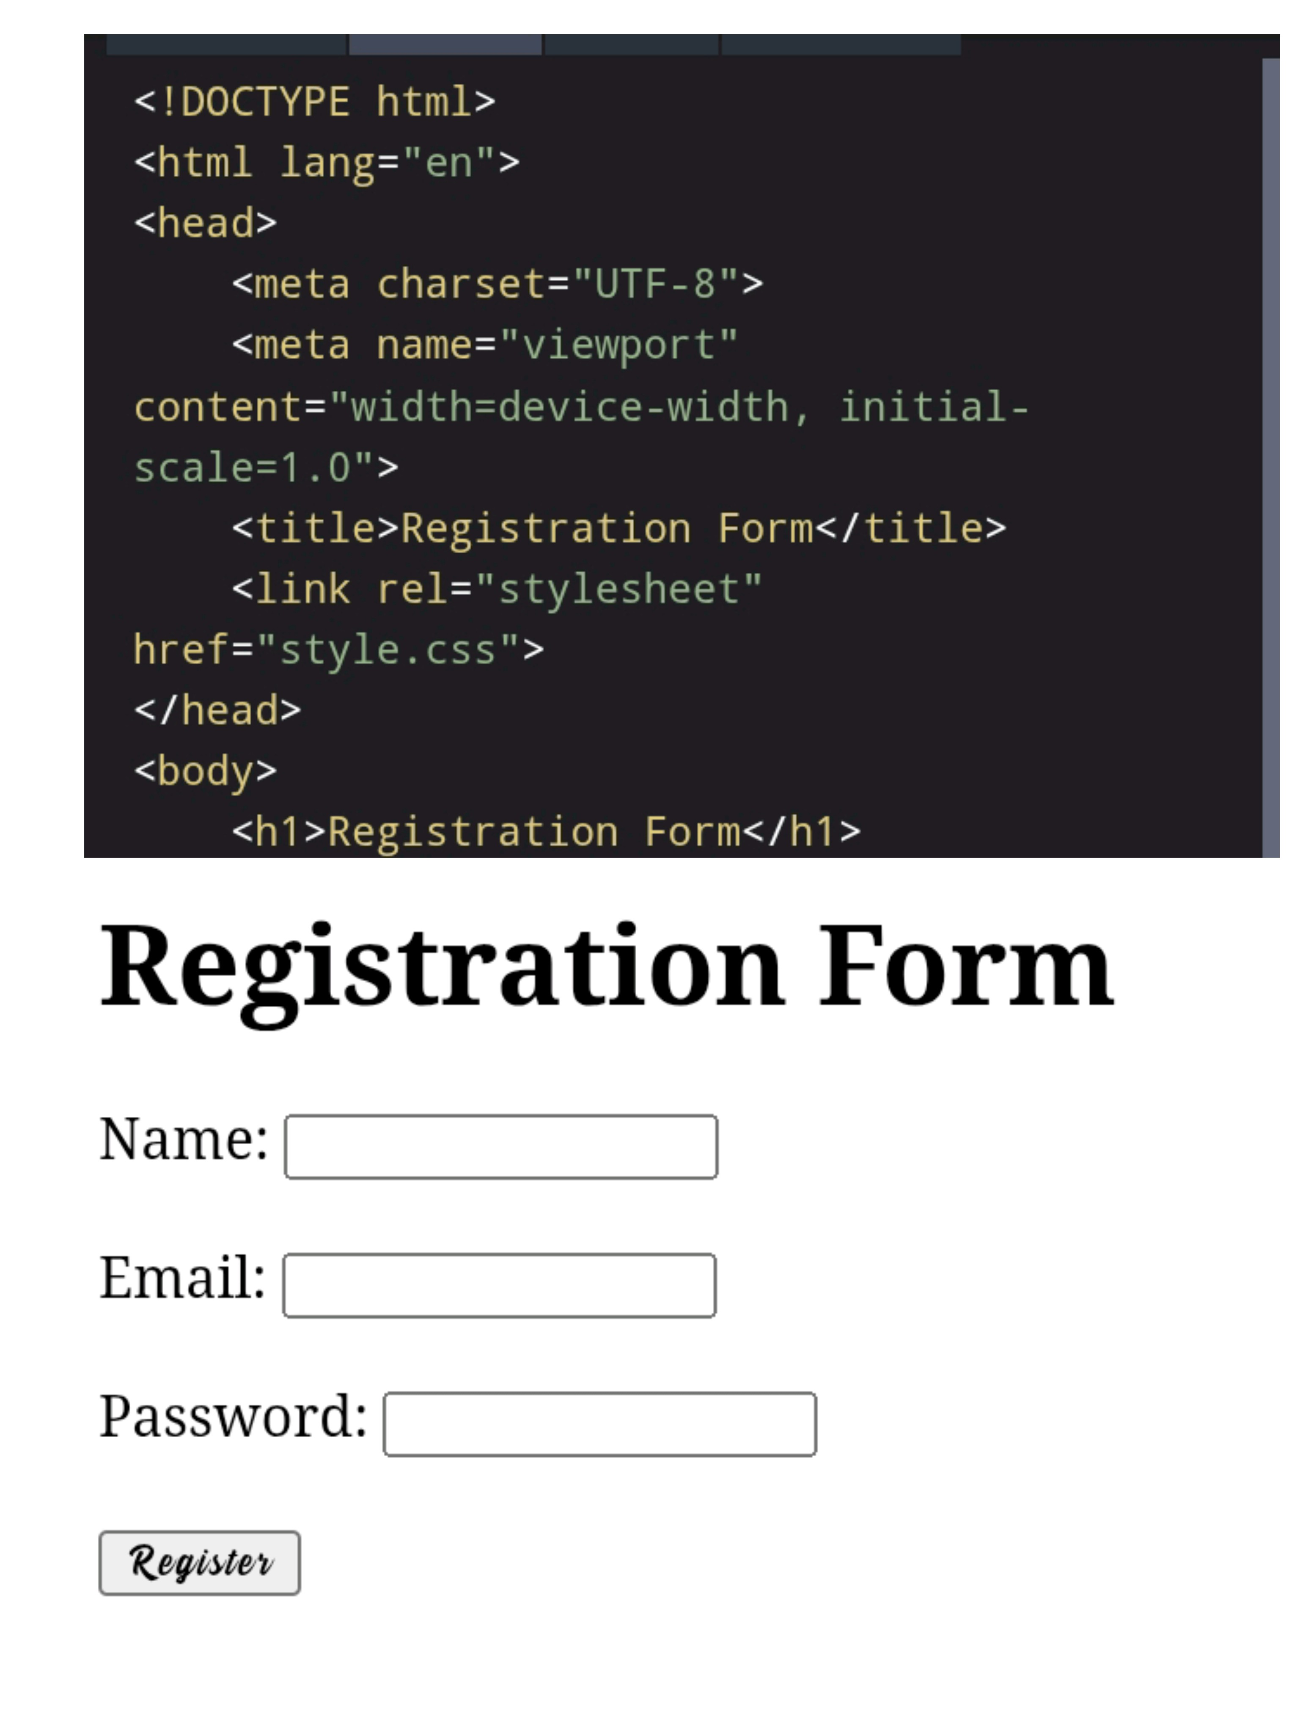

RESULTS AND TECHNIQUES
3/21/2024 Annual Review
10

Slide 11
CONCLUSION
Creating this digital portfolio has given me the opportunity to showcase my skills, knowledge, and growth in [your field/subject, e.g., web development, design, or academics]. It reflects not only the projects I have completed but also the learning process, challenges faced, and solutions developed along the way.
11

